Slide 1
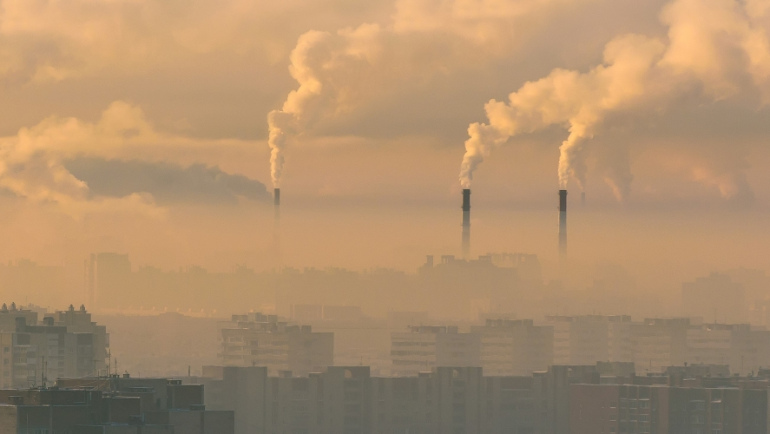
Predicting PM 2.5 Pollution Project
- By Samar Maithani

Slide 2

About the Project
This project aims to predict the PM 2.5 Air Pollution using the suitable weather data which is readily available. To solve this problem, firstly, exploratory data analysis will be conducted on available weather and pollution datasets to discover the correlation between different features. After applying suitable data cleaning and pre-processing methods, the machine learning techniques such as classification and regression models will be applied.

Slide 3
Project Workflow:
Importing the Data
Cleaning the Data
Training the Model
Creating a Model
Evaluation & Result
Making Predictions

Slide 4

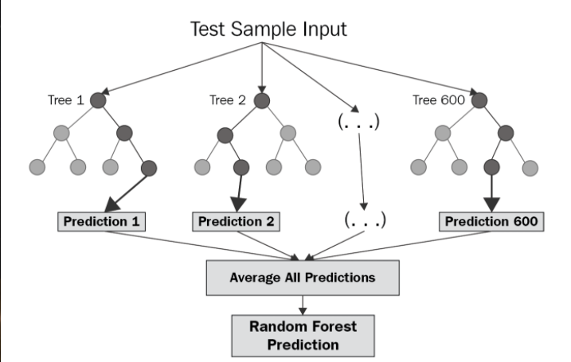
Random Forest Regression
Random Forest Regression is a supervised learning algorithm that uses ensemble learning method for regression. Ensemble learning method is a technique that combines predictions from multiple machine learning algorithms to make a more accurate prediction than a single model.
Identify your dependent (y) and independent variables (X)
Split the dataset into the Training set and Test set
Training the Random Forest Regression model on the whole dataset
Predicting the Test set results

Slide 5

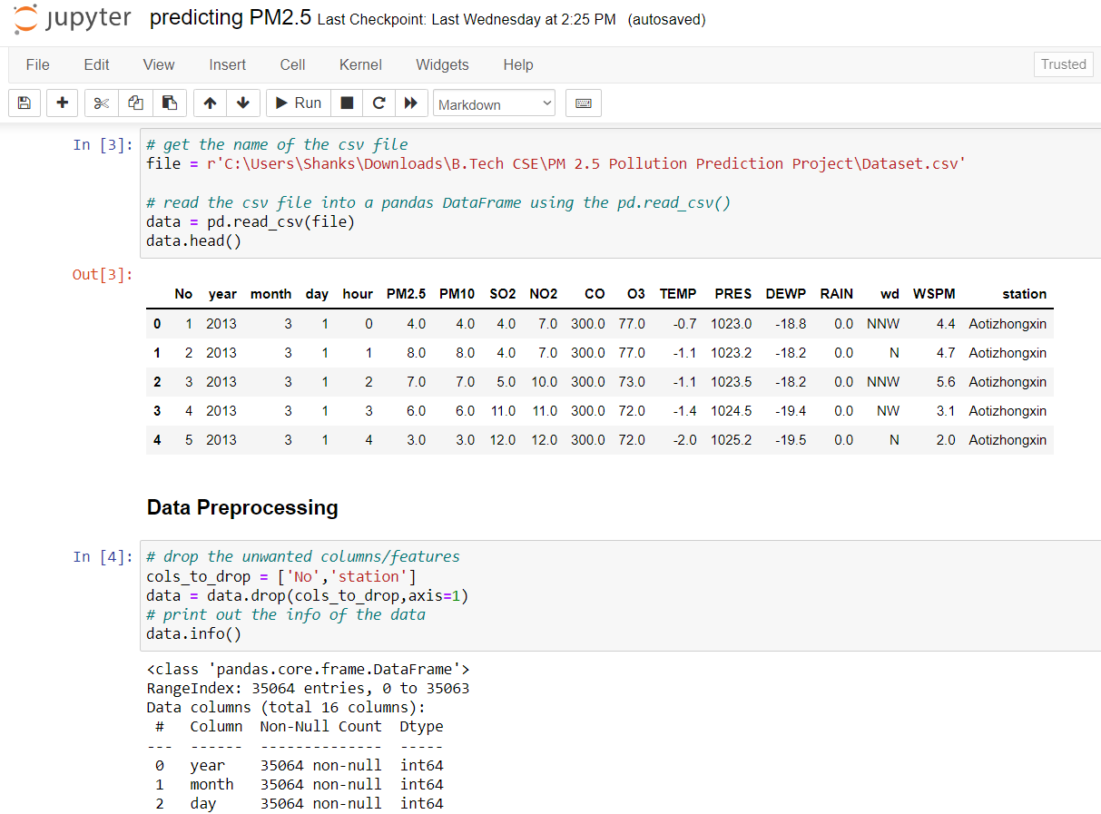
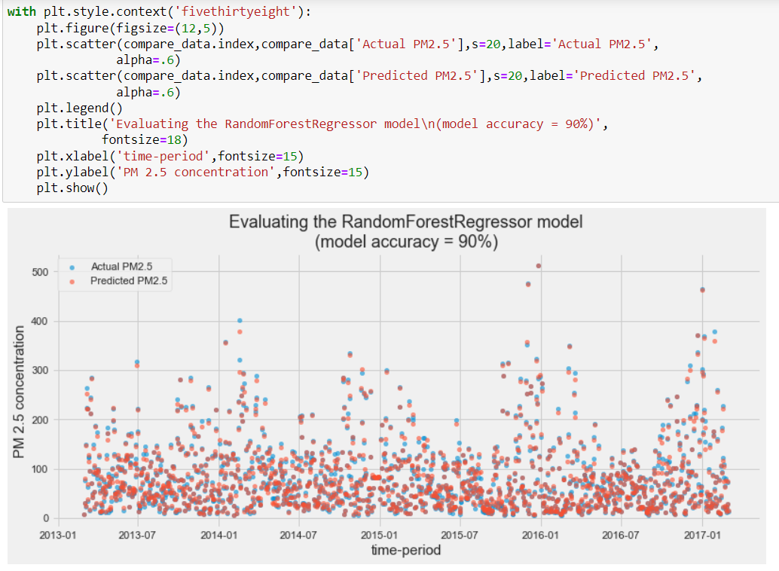
Screenshots from Project
Input Dataset
Output

Slide 6
Conclusion
In this project the machine learning model to analyze the air pollution based on weather data is made. These data are recorded in Beijing from 2013 to 2017. The particulate matter PM 2.5 prediction are done using machine learning technique of Random Forest Regression, which was able to predict the pollution with about 90% accuracy.
But even still, with some better tuning of the parameters in the model or by applying some other better machine learning techniques an improved model can be made that can provide us with higher performance. This model though great with 90% accuracy still holds a risk of making wrong predictions.

Slide 7
Thank You!

